Slide 1
Features of airway remodelling and the role of epithelial cytokines
Learn more about the histological features of airway remodelling in asthma and their associations with
epithelial cytokines

Slide 2
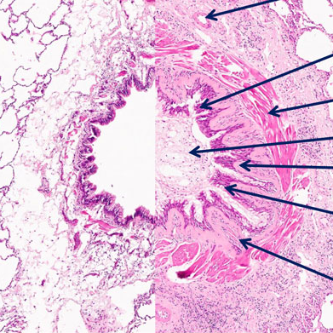
Features of airway remodelling in asthma
Angiogenesis
Altered epithelial barrier
Airway remodelling is heterogeneous and can be observed across the spectrum
of asthma severity¹
In asthma, airway remodelling refers to structural changes that can occur in both the small and large airways²
These structural changes
are orchestrated by crosstalk between a variety of immune
and non-immune cells within
the airway wall and submucosa^{2,3}
Increased airway smooth muscle mass
Mucus plugging
Basement membrane thickening
Goblet cell hyperplasia
Subepithelial fibrosis
Non-asthmatic
Fatal asthma
Figure adapted from Hsieh A, et al. Front Physiol 2023;14:1113100
1. Hsieh A, et al. Front Physiol 2023;14:1113100; 2. Varricchi G, et al. Allergy 2022;77:3538–3552; 3. Hough KP, et al. Front Med 2020;7:191
2

Slide 3
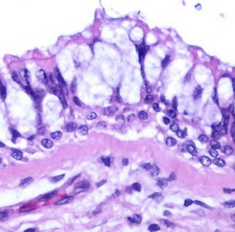
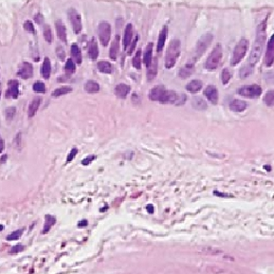
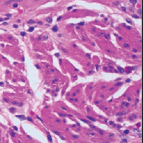
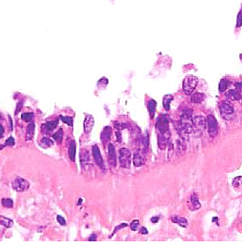
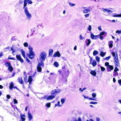
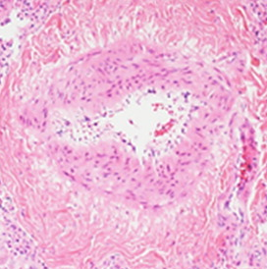
Structural consequences of airway remodelling
Goblet cell metaplasia
and increased mucus production^{1,2}
Increased basal
membrane thickness^{1,2}
Airway smooth
muscle hyperplasia
and hypertrophy³
Subepithelial fibrosis^{2,6}
Epithelial shedding^{2,4,5}
Angiogenesis⁷
Increased matrix
deposition leads to
airway narrowing
Promotes airway hyperresponsiveness
May contribute to
damage as external
insults penetrate the
airway wall
Can lead to fixed
airway obstruction
Promotes immune
cell infiltration
Airway blockage
Images adapted from Rosen Y. Bronchial goblet cell hyperplasia. 2009. In: Atlas of pulmonary pathology. Available from: https://www.flickr.com/photos/pulmonary_pathology/3705951876 (Accessed 6 April 2023), Shifren A, et al. J Allergy (Cairo) 2012;2012:316049, Doeing DC, Solway J. J Apply Physiol (1985) 2013;114:834–843, Kubo T, et al. Lab Invest 2019;99:158–168, Gordon IO, et al. Arch Pathol Lab Med 2009;133:1096–1105 and Galambos C, et al. Ann Am Thorac Soc 2018;15:1359–1362
1. Bartemes KR, Kita H. Clin Immunol 2012;143:222–235; 2. Holgate ST. Immunol Rev 2011;242:205–219; 3. Doeing DC, Solway J. J Appl Physiol 2013;114:834–843; 4. Yang Y, et al. Clin Respir J 2021;15:1027–1045;
5. Calvén J, et al. Int J Mol Sci 2020;21:8907; 6. Cohen L, et al. Am J Respir Crit Care Med 2007;176:138–145; 7. Keglowich LF, Borger P. Open Respir Med J 2015;9:70–80
3

Slide 4
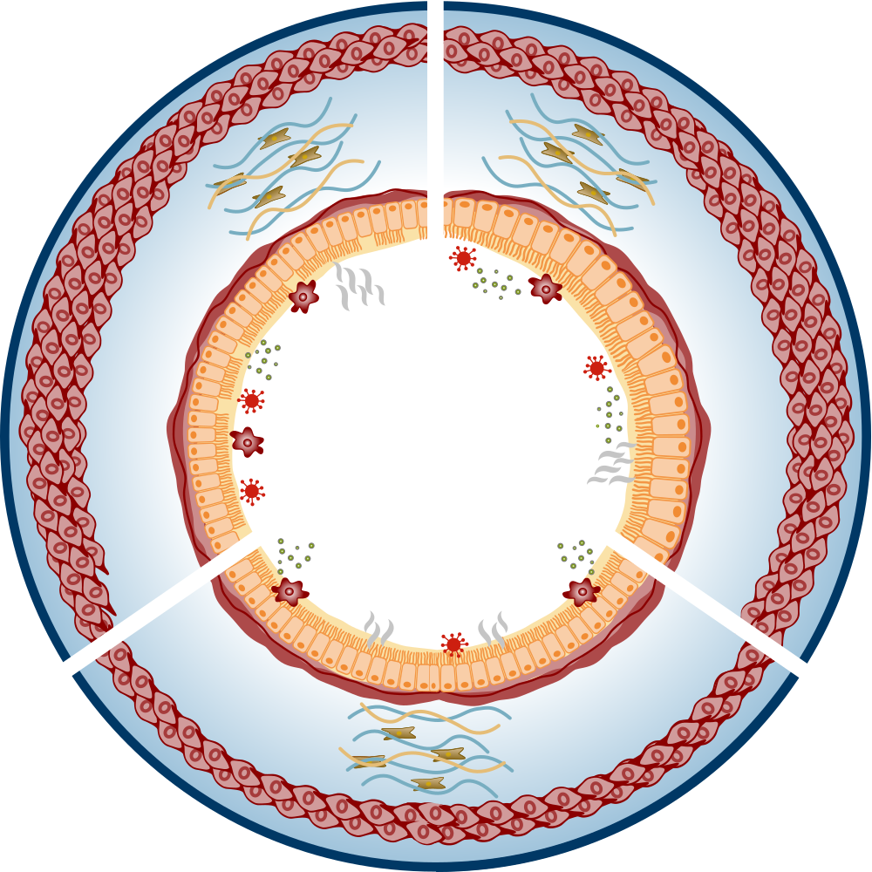
Epithelial cytokines can play diverse, yet often overlapping, roles in airway remodelling in asthma
TSLP
TSLP
TSLP activates lung fibroblasts which produce ECM molecules such as collagen type I and MMP-1^{1–3}
IL-33
IL-33 promotes the expression of
ECM components collagen and fibronectin 1 by lung fibroblasts^{8,9}
TSLP induces EMT in epithelial cells through the upregulation of TGF-β⁴
IL-33 directs airway smooth
muscle wound repair¹⁰
TSLP promotes migration and proliferation of airway smooth muscle cells⁵
IL-25 drives collagen secretion by lung fibroblasts⁶
IL-25 promotes the proliferation of lung fibroblasts⁷
IL-25
Evidence based on in-vitro experimental data
ECM, extracellular matrix; EMT, epithelial-mesenchymal transition; IL, interleukin; MMP-1, matrix metalloproteinase-1; TGF, transforming growth factor; TSLP, thymic stromal lymphopoietin
1. Cao L, et al. Exp Lung Res 2018;44:288–301; 2. Wu J, et al. Cell Biochem Funct 2013;31:496–503;​ 3. Jin A, et al. Biochim Biophys Acta Mol Cell Res 2021;1868:119083; 4. Cai L-M, et al. Exp Lung Res 2019;45:221–235;
5. Redhu NS, et al. Sci Rep 2013;3:2301; 6. Gregory LG, et al. Thorax 2013;68:82–90; 7. Xu X, et al. Exp Biol Med (Maywood) 2019;244:770–780; 8. Saglani S, et al. J Allergy Clin Immunol 2013;132:676–685;
9. Guo Z, et al. J Asthma 2014;51:863–869; 10. Kaur D, et al. Allergy 2015;70:556–567
4

Slide 5
Evidence for TSLP in airway remodelling in asthma
In human lung fibroblasts, TSLP increased expression of collagen and alpha-smooth muscle actin in vitro^{1,2}
In human airway smooth muscle cells, TSLP induced migration, which may contribute to increased smooth
muscle mass in vitro³
In human airway epithelial cells, TSLP downregulated epithelial marker
E-cadherin and upregulated mesenchymal marker vimentin in vitro⁴
250
Alpha-smooth muscle actin (N=3) Collagen (N=3)
Migrated cell number
E-cadherin (N=3) Vimentin (N=3)
1.0
†
†
2.0
¶
Relative protein level
200
§
¶
*
Protein level
¶
*
1.5
¶
150
‡
¶
¶
0.5
100
1.0
¶
50
0.5
0
0
0
0
1.5
2.5
4.0
Medium
TSLP
(1 ng/mL)
TSLP
(10 ng/mL)
0
1
10
100
TSLP concentration (ng/mL)
TSLP concentration (ng/mL)
N=4
Figures adapted from Cao L, et al. Exp Lung Res 2018;44:288–301, Redhu NS, et al. Sci Rep 2013;3:2301 and Cai L-M, et al. Exp Lung Res 2019;45:221–235
*P<0.05 vs GAPDH control (smooth muscle actin); †P<0.05 vs GAPDH control (collagen); ‡P<0.001 vs medium control; §P<0.01; ¶P<0.001
GAPDH, glyceraldehyde-3-phosphate dehydrogenase; TSLP, thymic stromal lymphopoietin
1. Cao L, et al. Exp Lung Res 2018;44:288–301; 2. Wu J, et al. Cell Biochem Funct 2013;31:496–503; 3. Redhu NS, et al. Sci Rep 2013;3:2301; 4. Cai L-M, et al. Exp Lung Res 2019;45:221–235
5

Slide 6
Evidence for IL-33 in airway remodelling in asthma
In human lung fibroblasts, IL-33 increased expression of fibronectin 1 and type I collagen in vitro^{1,2}
In human airway smooth muscle cells, IL-33 directed wound closure in vitro, which may contribute to smooth muscle repair in response to physical or inflammatory damage³
P=0.009
Fibronectin 1 /
β-actin (N=3)
40
6
Type I collagen /
β-actin (N=3)
Percentage wound healed
Relative protein level
P=0.02
5
*
P=0.03
30
4
†
†
20
3
*
2
10
1
0
+ 50 ng/mL IL-33
–
+
–
–
+
0
+
–
1
10
100
Isotype
–
–
+
–
+
IL-33
(ng/mL)
–
Anti-IL-33
–
–
–
+
–
+
Figures adapted from Guo Z, et al. J Asthma 2014;51:863–869 and Kaur D, et al. Allergy 2015;70:556–567
*P<0.05 vs controls; †P<0.01 vs controls
IL, interleukin
1. Guo Z, et al. J Asthma 2014;51:863–869; 2. Saglani S, et al. J Allergy Clin Immunol 2013;132:676–685; 3. Kaur D, et al. Allergy 2015;70:556–567
6

Slide 7
Evidence for IL-25 in airway remodelling
In human airway lung fibroblasts, IL-25 induced
extracellular collagen secretion in vitro¹
In human lung fibroblasts, IL-25 promoted
cell proliferation in vitro²
90
IL-25 (N=8–12)
4
†
Collagen mg/mL
PBS (N=8–12)
*
*
Optical density
†
75
3
60
45
2
30
*
1
15
0
0
1
10
100
0
8
24
48
N=3
Time (h)
IL-25 concentration (ng/mL)
Figures adapted from Gregory LG, et al. Thorax 2013;68:82–90 and Xu X, et al. Exp Biol Med (Maywood) 2019;244:770–780
*P<0.05 vs PBS control group; †P<001 compared with vehicle-treated fibroblasts after 72 hours
IL, interleukin; PBS, phosphate-buffered saline
1. Gregory LG, et al. Thorax 2013;68:82–90; 2. Xu X, et al. Exp Biol Med (Maywood) 2019;244:770–780
7

